Slide 1




Student Score Prediction using Machine Learning
Data Series 18.0
Presented by
Leta Lestari

Slide 2


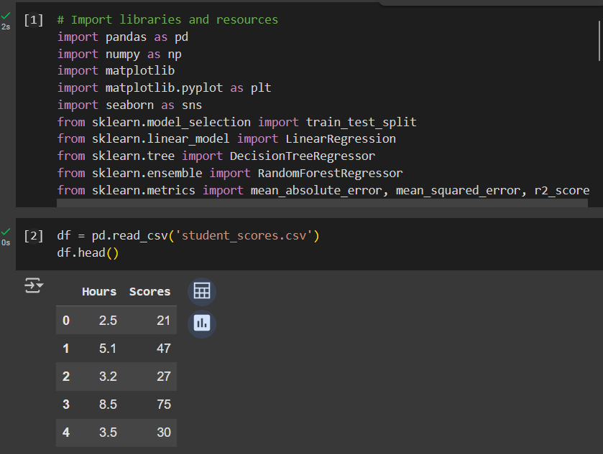

Project Overview
The Student Score dataset is used to analyze the relationship between study hours and student exam scores. Understanding this relationship can help in predicting student performance based on study time, which can be useful for educators, students, and academic institutions. By leveraging machine learning techniques, this project aims to develop a predictive model that accurately estimates student scores, providing insights into the impact of study habits on academic success.
Methods Used:
Exploratory Data Analysis (EDA)
Feature Engineering
Machine Learning Modeling
Evaluation & Selection

Slide 3
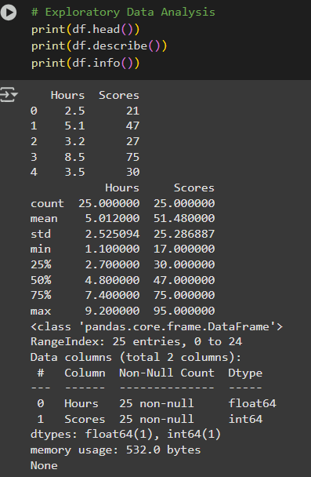
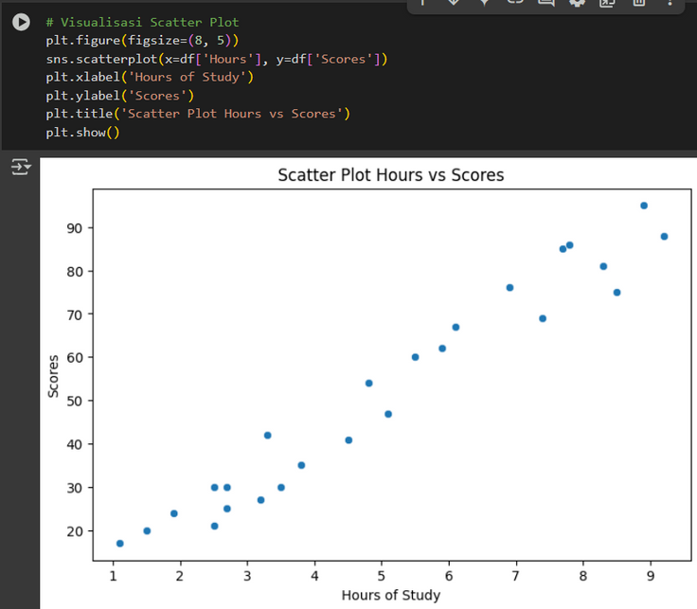


Exploratory Data Analysis (EDA)
Before building the model, the dataset needs to be cleaned and prepared. This includes checking for duplicate entries, handling missing values, and identifying potential outliers to ensure accurate predictions.
df.head() → display the first 5 rows of the dataset
df.describe() → Displays descriptive statistics.
df.info() → Displays dataset information.
Visualisasi scatter plot

Slide 4
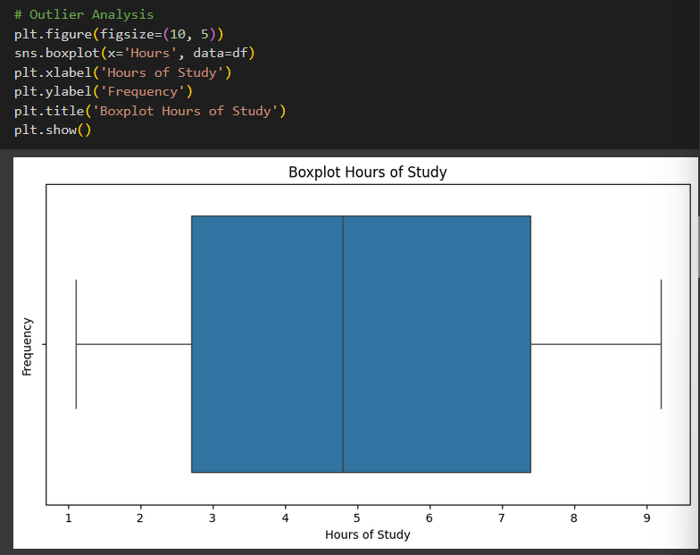
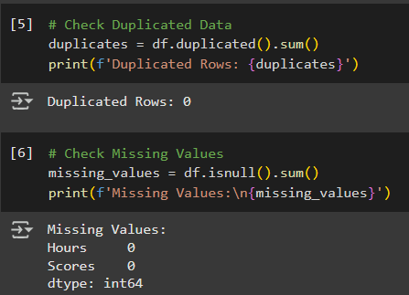


Feature Engineering
This slide presents the Feature Engineering stage, including checks for duplicates, missing values, and outliers. No duplicate or missing data was found. Outlier analysis uses a boxplot to visualize the distribution of Hours of Study.

Slide 5

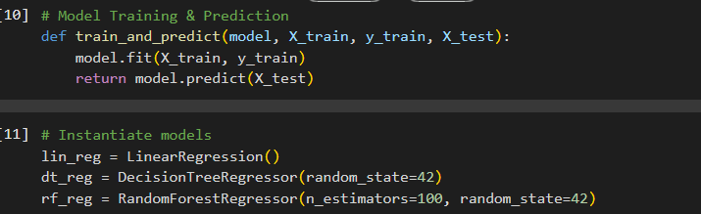
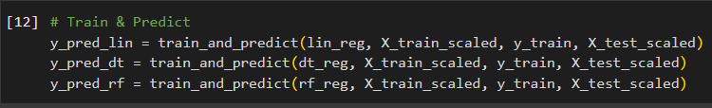
Modeling Machine Learning Regression
function trains the model and makes predictions.
Creates three models: Linear Regression, Decision Tree Regressor, and Random Forest Regressor.
Train & Predict → Each model is trained using scaled training data and then used for predictions on test data.

Slide 6

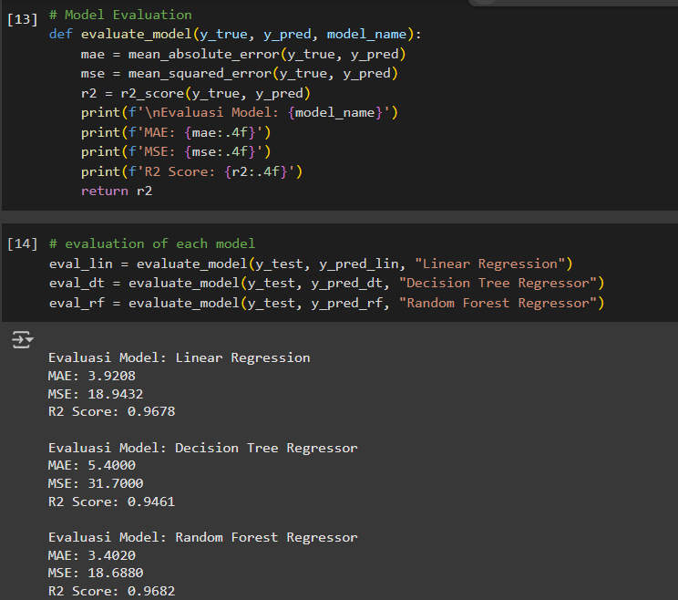
Evaluasi Model
The code evaluates three regression models using MAE, MSE, and R² Score. Random Forest Regressor performs best with the lowest MAE and highest R².

Slide 7


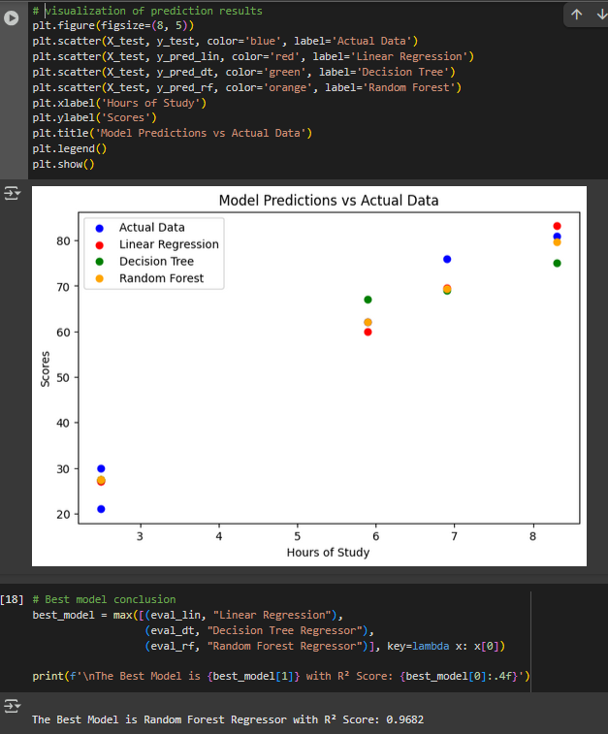

Visualization and Best Model
The graph compares actual data and predictions from three regression models.
Random Forest Regressor performs best with the highest R² (0.9682), indicating the most accurate predictions.

Slide 8





Thank You
@letalstry_
Leta Lestari
letalestari02668@gmail.com

